Slide 1
Intrahepatic Cholestasis of Pregnancy (ICP)
Dr. Z. Mohsenpour
February 2024

Slide 2
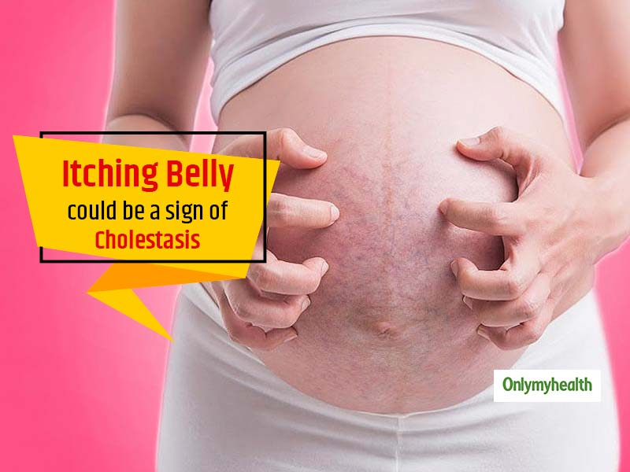
Intrahepatic Cholestasis of pregnancy
It is characterized by pruritus with elevated serum bile acids concentrations or abnormal LFTs typically developing in the late second and/or third trimester and rapidly resolving after delivery.
Incidence
ICP is the most common liver disease in pregnancy with prevalence 0.3%–5%.
Pathophysiology involves reduced bile flow, leading to bile salt deposition in the skin and placenta .

Slide 3
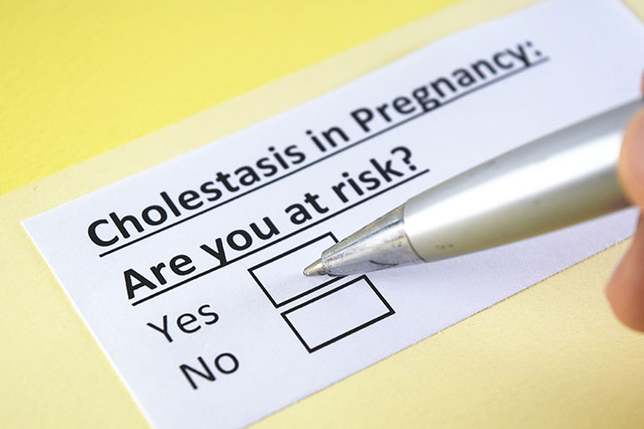
Risk factors
A past history of ICP is a strong risk factor for recurrence in subsequent pregnancies.
Personal or family history of the disorder or secondary to OCP
Multiple gestation
Pre-existing hepatitis C , cholelithiasis , non alcoholic fatty liver disease, AIH
Advanced maternal age ( older than 35 Y/O )

Slide 4
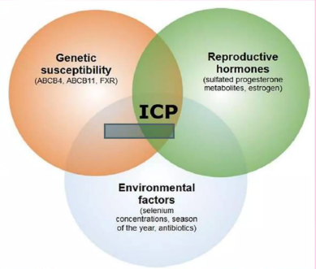
Etiology
Genetic susceptibility Increased risk in FDR, some ethic groups
Hormonal factors Increased estrogen, Altered progesterone metabolism
Environmental factors Low selenium diet, Low vitamin D level

Slide 5
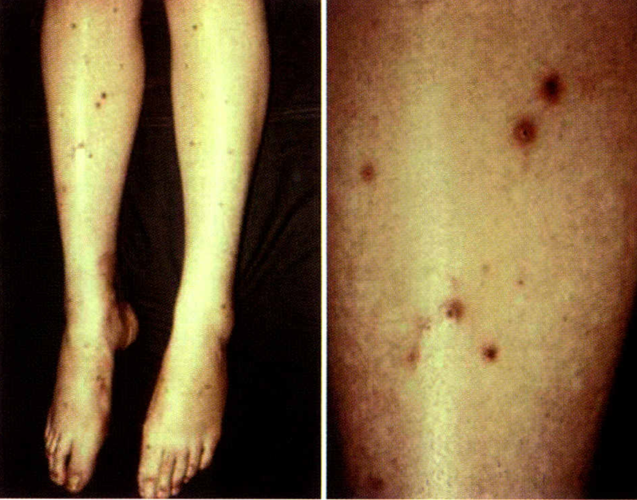
Clinical Manifestation
The first symptom of ICP is typically pruritus, which ranges from mild to intolerable, often generalized, and predominates on the palms and soles and is worse at night.
Pruritus and other symptoms usually develop during the late second or third trimester. However, presentations as early as week 7 of gestation have been documented, transient first trimester symptoms have been linked to ovarian hyperstimulation syndrome after IVF.
scratch marks, excoriations, and prurigo nodules secondary to scratching

Slide 6
Symptoms
Right upper quadrant pain
Nausea
Poor appetite
Sleep deprivation
Fat malabsorption and steatorrhea can result in fat-soluble vitamin deficiency
Jaundice: typically developing one to four weeks after the onset of itching .

Slide 7
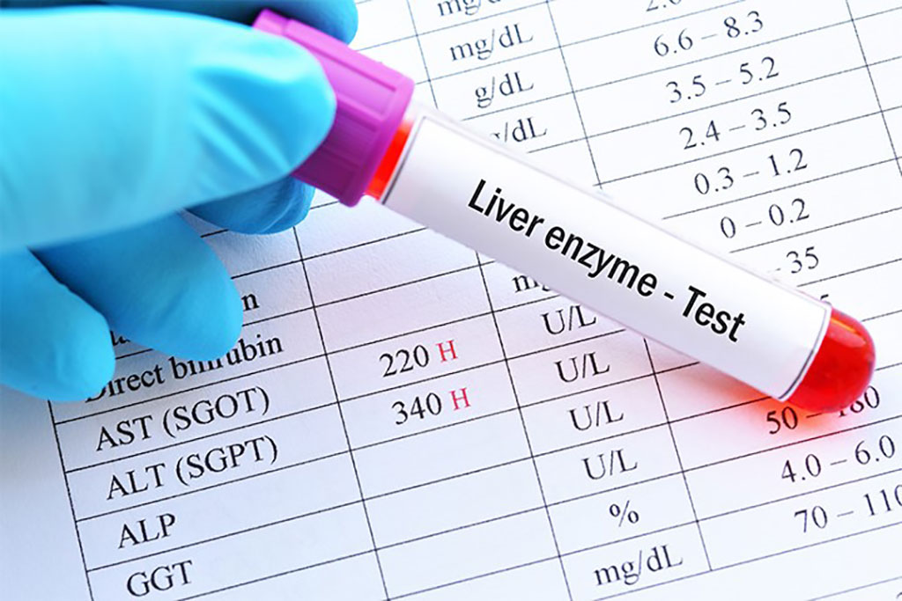
Laboratory Findings
Elevated bile acids
An increase in serum total bile acid concentration is the key laboratory finding (present in >90 % of affected pregnancies)
May be the first and only laboratory abnormality
TBA level >10 μmol/L being diagnostic, and Severe cholestasis is defined as bile acids over 40 μmol/L .
Serum aminotransferases are increased in 60% of cases
Usually less than two times the upper limit of normal, seldom exceed 200 U/L but may reach values greater than 1000 U/L, making distinction from viral hepatitis important .
Alkaline phosphatase is increased, possibly fourfold, but this is not specific for cholestasis during pregnancy due to expression of the placental isoenzyme.
To next page

Slide 8
Laboratory Findings
Total and direct bilirubin concentrations are increased in 25%of cases, although total bilirubin levels rarely exceed 6 mg/dL.
Gamma-glutamyl transpeptidase (GGT) is usually normal but modestly elevated in 30% of cases
The PT is usually normal. When prolonged, it is typically secondary to vitamin K deficiency from fat malabsorption due to severe steatorrhea postpartum hemorrhage is rare.

Slide 9
Diagnosis
ICP should be suspected in any pregnant patient in the late second or third trimester with pruritus unrelated to a rash.
The diagnosis is confirmed when pruritus is associated with:
Elevated total serum bile acid levels
Elevated aminotransferases, or both
Excluding other diagnoses, which can cause similar symptoms and lab abnormalities.
If the patient continues to complain of pruritus and initial biochemical tests are normal, we recommend repeating laboratory tests because pruritus may precede biochemical abnormalities by several weeks.
To next page

Slide 10
Diagnosis
ICP is not associated with abnormalities on imaging (biliary ducts are not dilated, hepatic parenchyma appears normal).
Cholestasis may occur in conjunction with other liver diseases, ultrasound should be performed to exclude cholelithiasis.
History, physical examination, and laboratory evaluation are performed to rule-in the diagnosis and rule-out other disorders in differential diagnosis.

Slide 11
Clinical Points in Differential Diagnosis
The differential diagnosis of cholestasis in pregnancy categorizes into two groups, conditions causing pruritis and conditions, causing elevated liver function.
Two key clinical points in differential diagnosis include:
Pruritus, the cardinal feature of ICP, helps distinguish ICP from other types of pregnancy-related disorders characterized by elevated aminotransferaselevels (e.g., HELLP syndrome , acute fatty liver of pregnancy).
The lack of primary skin lesions in ICP helps to differentiate it from most pregnancy-specific pruritic dermatoses and skin conditions unrelated to pregnancy.
11
To next page

Slide 12
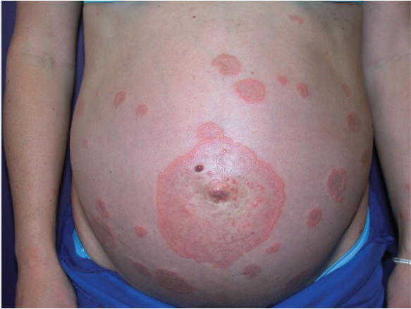
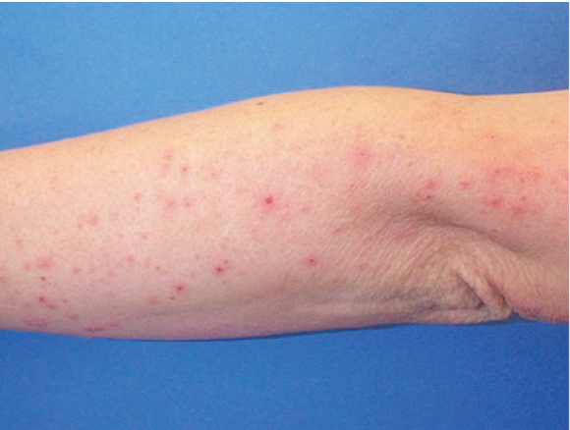
Differential Diagnosis
Conditions Causing Pruritis
Pemphigoid gestationis
Pruritis gravidarum
Prurigo in pregnancy
Atopic dermatitis
Allergic reactions
Conditions Causing Impaired Liver Function
HELLP syndrome
Acute fatty liver of pregnancy
Viral hepatitis
Primary biliary cirrhosis
Drug-induced liver damage
Pemphigoid gestationis
Prurigo

Slide 13
Fetal Effect
Maternal bile acids cross the placenta. Accumulation of bile acids in the fetus and amniotic fluid and carries significant risk for the fetus .
The main complications are increased risks for :
Sudden IUFD :
The risk of stillbirth also increased with increasing gestational age, particularly beyond 34 to 36 weeks.
Highest when TBA ≥100 μmol/L
Most stillborn infants are of appropriate weight and have no evidence of uteroplacental insufficiency.
To next page

Slide 14
Pathophysiology of Adverse Pregnancy Outcome
IUFD may be related to the sudden development of :
1. fetal arrhythmia ( due to the cardiotoxicity of bile acids )
or
2. vasospasm of the placental chorionic surface vessels induced by high levels of bile acids ( possibly due to an acute anoxic event) .
IUGR and oligohydramnios are not features of the disease .

Slide 15
Fetal Effect
Meconium-stained amniotic fluid:
May be related to the toxic effects of bile acids or may be a consequence of bile acids stimulating gut motility.
Preterm birth (spontaneous and iatrogenic) :
Consequence of bile acid–induced release of prostaglandins , increase expression of myometrial oxytocin receptors.
RDS:
Which appears to be associated with bile acids entering the lungs .

Slide 16
Management
The management of ICP has two main goals:
1. Reducing bothersome symptoms
2. Reducing the risk of perinatal morbidity and mortality
Candidates for treatment :
For patients with characteristic clinical symptoms but normal serum bile acid and aminotransferase levels, either treatment can be initiated empirically or laboratory tests can be repeated weekly with treatment initiated once TBA or serum aminotransferase levels or both are elevated.

Slide 17
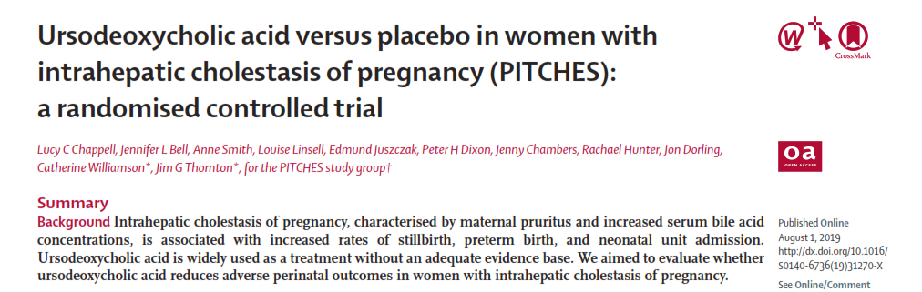
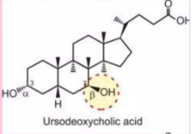
Ursodeoxycholic acid (UDCA) is the first-line treatment recommended for IHCP by ACG, ACOG, AASLD and EASL
Prescribe 300 mg TID (or 15 mg/kg per day) until delivery , may be increased to a maximum 2000 mg daily , is also reasonable.
UDCA is the only drug that has consistently been shown to improve the maternal symptoms and biochemical features of ICP.
A decrease in pruritus is usually seen within one to two weeks, and biochemical improvement is usually seen within three to four weeks.
To next page

Slide 18
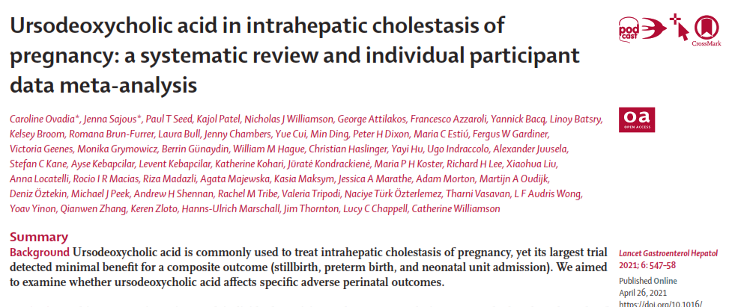
If pruritus is not relieved to a tolerable level within about two weeks, the dose is titrated every week or two to symptoms , to a maximum dose of 21 mg/kg per day .
If UDCA is started empirically, elevated bile acid and aminotransferase levels may never be detected.
UDCA treatment improves the serum bile acid levels measured in cord blood and amniotic fluid at the time of delivery, but did not lower fetal risk.

Slide 19
Post-treatment Laboratory Monitoring
Follow-up bile acid levels
Clinical decision-making is based on the highest TBA level at any point during the pregnancy, maternal obstetrical history, and symptoms.
Repeat evaluation of maternal TBA concentrations can be considered as often as weekly due to the significantly increased risk of stillbirth in patients with TBA ≥100 μmol/L which would favor earlier delivery .
Do not increase the UDCA dose to reduce elevated laboratory results if pruritus has been relieved and we would not revise the planned time of delivery if laboratory abnormalities improve.

Slide 20
Refractory Cases
If the maximum dose of UDCA is reached and pruritus remains intolerable, one of the following drugs can be added:
S-adenosyl-methionine: (recommended by AASLD, RCOG, ACOG and EASL)
Cholestyramine: (recommended by AASLD and ACOG)
Rifampin: (recommended by AASLD, ACOG and EASL)
Other drugs :
Alternative drugs may be considered in patients who are unable to take UDCA, but none have comparable efficacy .
Hydroxyzine or chlorpheniramine has been used to treat pruritus with minimal efficacy, but provides sedation at night.
Calamine lotion or aqueous cream.
Dexamethasone did not improve pruritus or reduce the serum aminotransferase levels .

Slide 21
Pregnancy Management
Antepartum fetal assessment
Follow all pregnancies with ICP with twice weekly modified BPP.
Although the value of antepartum fetal testing to identify fetuses at risk of demise in the setting of ICP is unproven
Several study reported fetal demise occurring within a few days of a reactive NST.
Fetal testing for detecting the fetal effects of chronic placental insufficiency may not be useful in ICP because the mechanism of fetal demise is thought to be a sudden event rather than the result of a chronic placental vascular process.
Many obstetricians order antepartum testing in patients with ICP to detect the rare test suggesting fetal compromise and the need for immediate delivery.

Slide 22
Timing of Delivery
Early delivery is the only known intervention that reduces the risk of stillbirth
Timing is generally based on the highest TSBA concentration at any time during the pregnancy.
TSBA level < 40 μmol/L: Delivery at 37^{0/7th} to 38^{6/7th} weeks .
TBA level , 40 to 99 μmol/L : Delivery at 36^{0/7th} to 37^{0/7th} weeks .
TBA level ≥ 100 μmol/L : Delivery at 36^{0/7th} weeks.
To next page

Slide 23
Timing of Delivery in ICP
To next page

Slide 24
Timing of Delivery in ICP
Consider delivery prior to 36 weeks in patients with:
Excruciating and unremitting maternal pruritus not relieved with pharmacotherapy
Worsening hepatic function (e.g., continued increases in transaminases or TBA concentration despite UDCA treatment)
A prior history of fetal demise before 36 weeks due to ICP with recurring ICP in the current pregnancy
The timing of delivery in these situations is empirical and generally delayed as long as possible after 34^{0/7th} weeks of gestation, depending on the individual patient's particular circumstances (severity of symptoms, gestational age of previous fetal demise, values, and preferences).
To next page

Slide 25
Timing of Delivery in ICP
ACOG / SMFM recommends
For patients with TBA levels <100 μmol/L , delivery is recommended at 36^{0/7th} to 39^{0/7th} weeks of gestation
For patients with TBA levels ≥100 μmol/L, delivery is recommended at 36^{0/7th} weeks.
National protocol
Termination of pregnancy at 36th week after corticosteroid injection, if it occurs after the 37th week of pregnancy, termination of the pregnancy as soon as the diagnosis is made.
Re-evaluation of LFT 6-8 weeks after delivery.

Slide 26
Follow-up post partum
Pruritus and laboratory abnormalities rapidly resolve after delivery.
LFT and bile acid concentration levels should be rechecked if the patient continues to have clinical symptoms after delivery.
If laboratory abnormalities do not return to normal, the patient should be referred to a hepatologist to assess for underlying hepatobiliary diseases.
ICP may be associated with subsequent diagnosis of gallstone disease, hepatitis C, fibrosis, cholangitis, hepatobiliary cancer, pancreatic disease, immune-mediated disease, and cardiovascular disease .
To next page

Slide 27
Follow-up post partum
The increased risk for cardiovascular disease was only in those individuals with ICP who also had preeclampsia .
There is a risk of future hepatobiliary diseases
Cholestasis recurs during subsequent pregnancies in 60 to 70 percent of patients with ICP.

Slide 28
Contraception
Estrogen-progestin
The administration of estrogen-progestin contraceptives to patients with a history of ICP rarely results in recurrent cholestasis.
Combined hormonal contraceptives can be initiated after normalization of LFT. However, patients should be informed of the possible development of pruritus or cholestasis, which should prompt discontinuation of the combined hormonal contraceptive.
Routinely check LFT after 3-6 months of such contraception.
Progestin-only :
The CDC consider progestin-only contraceptives an acceptable choice for patients with a history of ICP or cholestasis related to use of estrogen-progestin contraceptives .
The risk of recurrent cholestasis is low.

Slide 29
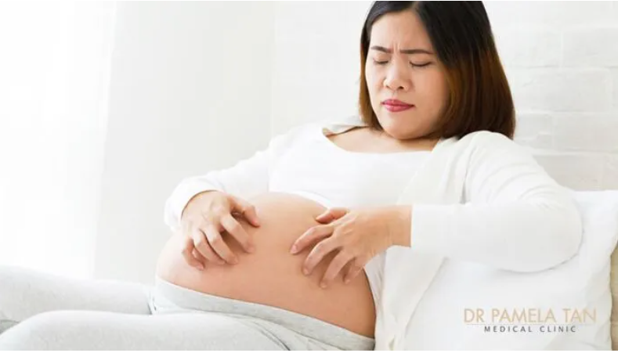
Prevention
It is not possible to prevent the condition in predisposed women, although it is possible to screen for biochemical abnormalities before symptoms occur.
If a woman with a history of ICP requires antibiotics, it is advisable to avoid drugs that more commonly cause cholestasis in susceptible individuals, such as :
Erythromycin
Flucloxacillin
Amoxicillin–clavulanic acid

Slide 30
For your attention

